Slide 1
F
Face Find
Find Your Photos.
🤳
Instantly.
AI-powered face recognition for event photography.
Guests scan a QR code, take a selfie — and find every photo of themselves in seconds.
● Team - 7
1 / 9

Slide 2
TEAM
Member Roles & Responsibilities.
Jash Berawala
Jay Shah
Full Stack Lead
Frontend Developer
Backend API (Node.js/Express)
React.js Application
GitHub Management
Admin Dashboard Interface
ML Integration
Guest Photo Gallery
API Development & Testing
Responsive Design & State Mgmt
Niraj Patil
Chetan Patel
ML Engineer
Database Administrator/bA
Face Detection & Recognition
AWS S3 Integration
Python Microservice (FastAPI)
Database Architecture (MongoDB)
Face Clustering (DBSCAN)
Docker Containerization
Model Performance Optimization
Security & QR Code System
FaceFind · CS 691 · Team 7
4 / 17

Slide 3
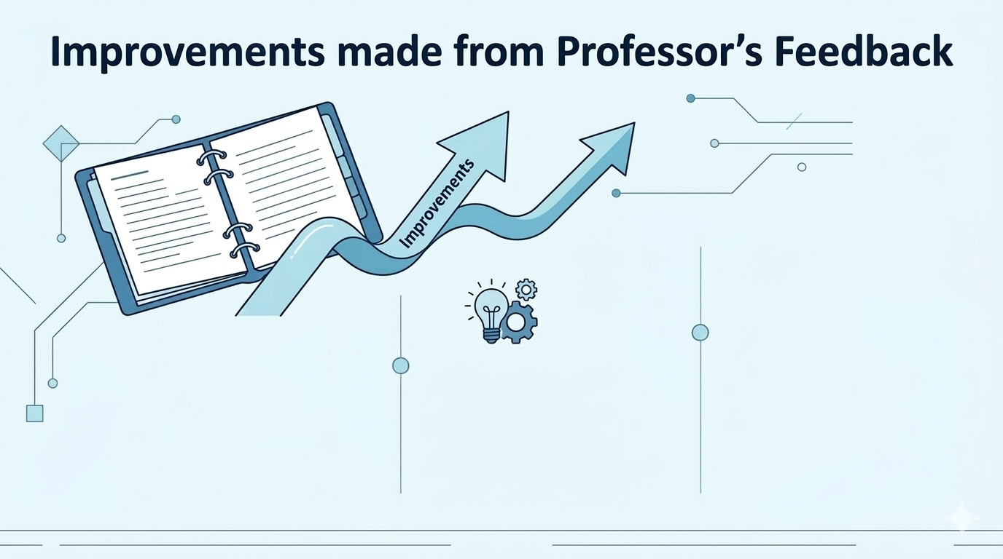
Project Description made more Simple.
Changes made in Personas
Error correction in Technologies(described)

Slide 4
THE PROBLEM
Event photos are
impossible to find.
“
I spent 2 hours scrolling through 3,000 wedding photos just to find 12 pictures of myself.
😩
Thousands of photos
Photographers upload 1,000–5,000+ images per event.
🔍
No way to search
— Event Attendee
Guests have no tool to find photos of themselves.
94%
⏳
Hours wasted
Manual searching kills the joy of the moment.
of guests never find all their photos
FaceFind · CS 691 · Team 7
2 / 9

Slide 5
THE SOLUTION
FaceFind.
Scan. Snap. See yourself.
01
02
03
04
📸
📱
🤳
✨
Photographer Uploads
Guest Scans QR
Takes a Selfie
Instant Match
Creates an event, uploads all photos. AI processes and indexes every face automatically.
Attendees scan the unique QR code at the venue to access the guest portal instantly.
Upload or take a selfie directly in the browser — no app download required.
AI matches your face against all event photos and returns your results in under 5 seconds.
FaceFind · MVP
3 / 9

Slide 6
PRODUCT
Built for Photographers,
Loved by Guests.
🎯
AI Face Indexing
⚡
< 5 Second Match
Every uploaded photo is automatically processed and indexed by face embedding.
Guests receive matched results in under 5 seconds using vector similarity search.
📱
No App Required
🔐
Photographer Auth
Fully browser-based. Guests just scan a QR code — nothing to install.
Secure JWT-based login. Each photographer sees only their own events.
📊
Live Dashboard
🔗
QR Code Sharing
Real-time processing updates via WebSockets. See photos processed as they upload.
Auto-generated QR codes per event. Share with guests in seconds.
FaceFind · MVP
4 / 9

Slide 7
TEAM WORKING AGREEMENT
Our Commitment to Each Other.
1. Communication
Primary platform: Microsoft Teams / Google Meet
Respond to messages within 12 hours
Blockers & delays communicated promptly and transparently
2. Meetings
Attend all sprint ceremonies: Planning, Backlog Grooming ,Reviews
Arrive prepared with updates and blockers
Retrospectives conducted with candor and respect
3. Work Expectations
Complete assigned tasks before the deadline
Avoid last-minute submissions
Submit work for peer review before merging to main
Communicate blockers early so the team can adjust
FaceFind · CS 691 · Team 7

Slide 8
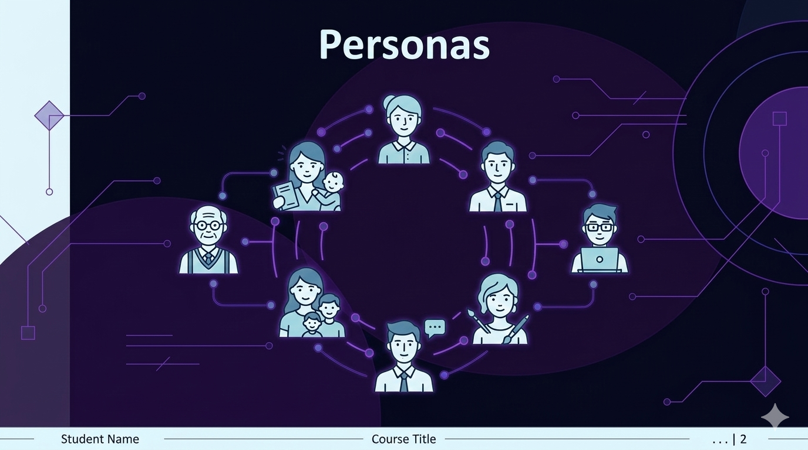

Slide 9
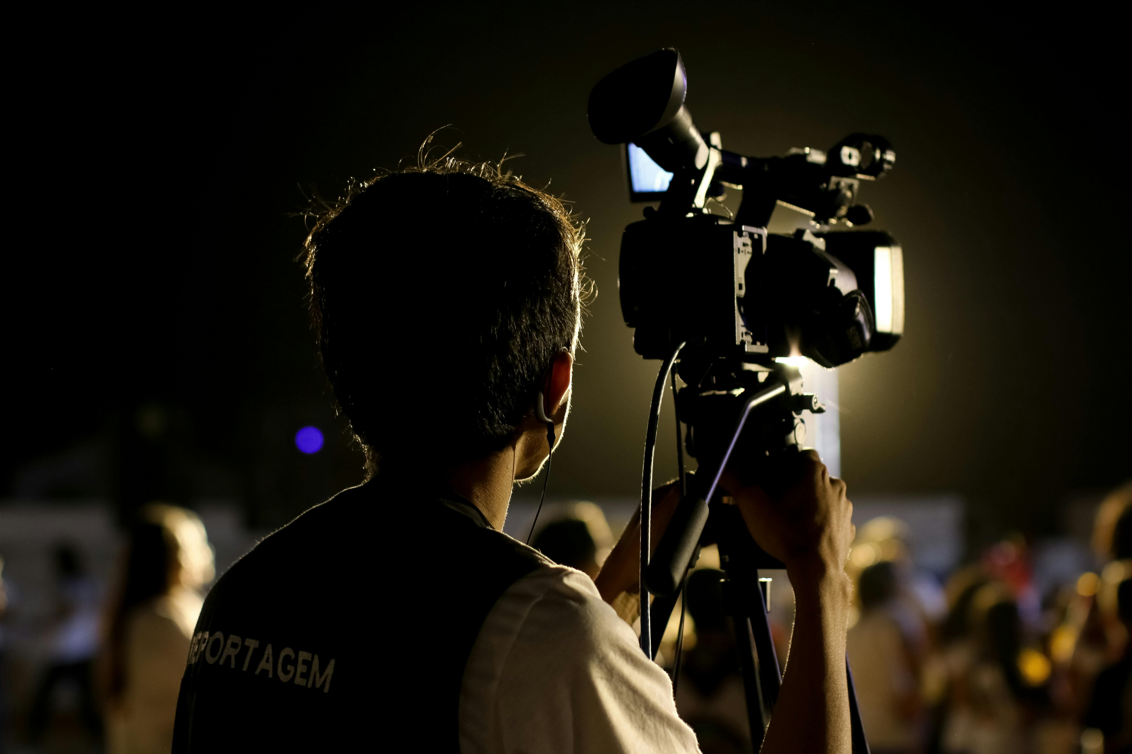
Frustration
Manual folder creation and link sharing takes 5-6 hours per event
Constant client requests: "When will photos be ready?"
No easy way to provide partial access during events
Link sharing management is cumbersome
Lost referral opportunities from untagged photos
Profile
Full-time Event Photographer
8 years experience
Shoots 3-4 events/week
800-1200 photos per event
Specializes in weddings &
corporate events
Goals
Reduce photo delivery time from hours to minutes
Improve client satisfaction with faster turnaround
Focus more on photography and client acquisition
Increase bookings through referrals
Build brand via photo tags
How FaceFind Helps
Creates event in 30 seconds
AI handles photo distribution
Guests self-serve via QR code
Real-time processing during breaks
Automatic tagging for referrals
Frees 5+ hours per event
Demographics
Name : Alex Reynolds
Age: 31
Location: Denver, CO
Business: Moments by Alex Photo
Quote
"I spent 6 hours last night just organizing and sending photos from Saturday's wedding. That's time I could have been shooting, marketing, or actually living my life. If guests could just scan a QR code and instantly get their photos, I'd be a hero."
— Alex Reynolds, Professional Photographer

Slide 10
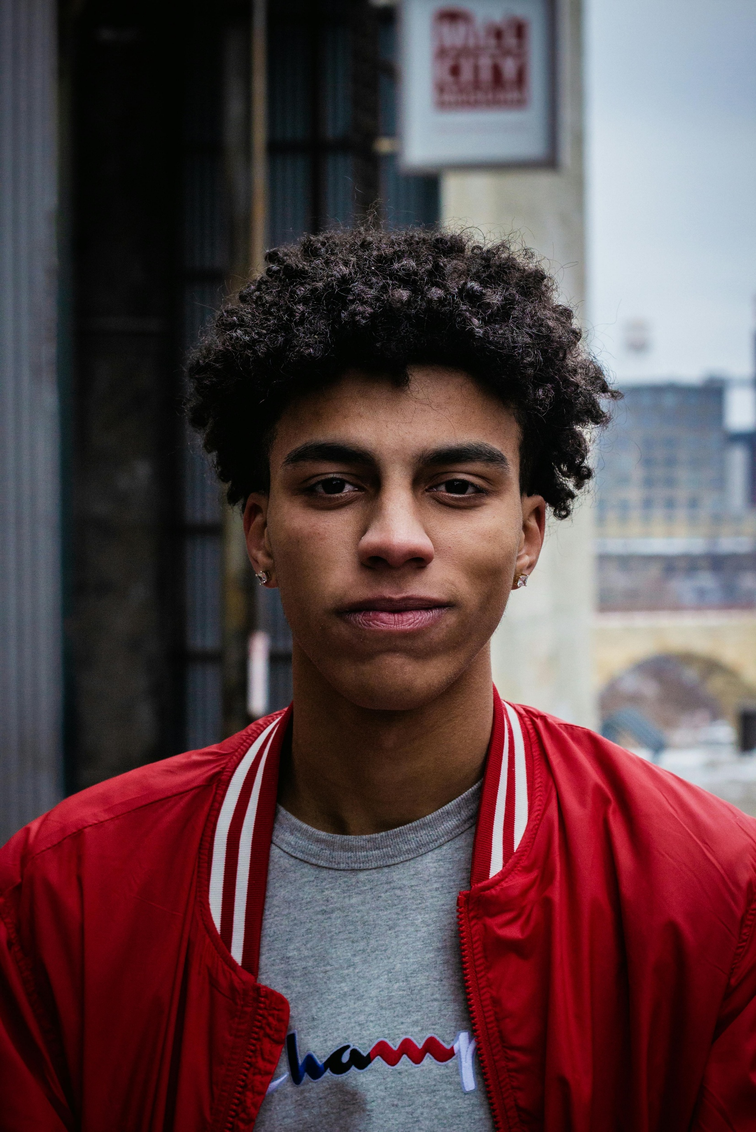
Profile
Marketing Manager with 5+ years experience
Attends 8-10 weddings annually
Active on Instagram & LinkedIn
Posts within 24 hours for max engagement
Values professional quality photos
Frustration
Receives photo links 3-4 weeks after events. Must scroll through 800+ photos to find himself Misses social media engagement window. Phone photos are poor quality. Takes photos during events instead of enjoying
Goals
Get photos immediately while memories are fresh
Easily find photos of himself without scrolling
Share to social media during the event
Enjoy events without phone distraction
Build social media presence
How FaceFind Helps
Scan QR code at event entrance
Upload one selfie
AI finds ALL photos of Marcus
Instant access to professional photos
Share during event when engagement peaks
Selfie deleted immediately after matching
Demographics
Name : Marcus Thompson
Age : 28
Location : Atlanta, GA
Occupation : Marketing Manager
Education : MBA, Emory University
Quote
"I just got the photo link from my cousin's wedding THREE WEEKS after the event. The moment has passed, everyone's moved on. Scrolling through 900 photos to find the 3 where I look decent is exhausting. Why can't someone just send me MY photos?"
— Marcus Thompson, Wedding Guest

Slide 11

Profile
Senior Events Manager with 12 years experience Organizes 15-20 corporate events annually Manages $3M annual event budget
Average event: 100-500 attendees Reports to C-suite leadership Data-driven decision maker
Frustration
No way to track photo engagement or ROI. Privacy concerns with employee photos. Can't prove event value with hard data. Post-event follow-up has low response rates. Budget justification difficult without metrics
Leadership asks: "What did we get for that investment?"
Goals
Quick, secure photo delivery to employees
Track engagement and measure ROI
Control access with email whitelisting
Generate reports for leadership
Ensure data privacy and compliance
Demonstrate event value beyond attendance
How FaceFind Helps
Private events with email whitelist
Detailed analytics dashboard
Exportable reports for leadership
Automatic session expiration
Corporate branding integration
GDPR/CCPA compliant
73% engagement in 48 hours
Demographics
Name : Jordan
Age : 40
Location : Chicago, IL
Company : Global Tech Solutions
Position :Senior Events Manager
Quote
"Last year's leadership summit cost $250,000. When the CFO asked what we got for it, all I had was attendance numbers and some nice photos. Now I can show exactly how many people engaged, shared, and downloaded. That's how I justify next year's budget."
— Jordan Chen, Senior Events Manager

Slide 12
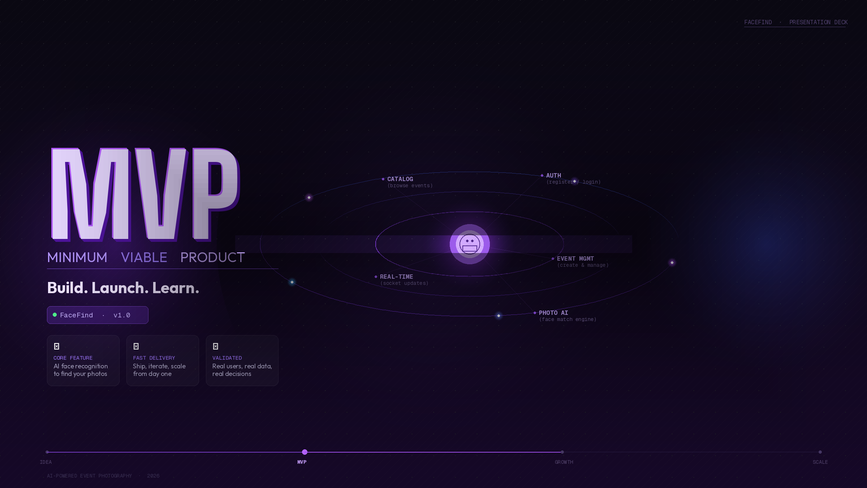

Slide 13
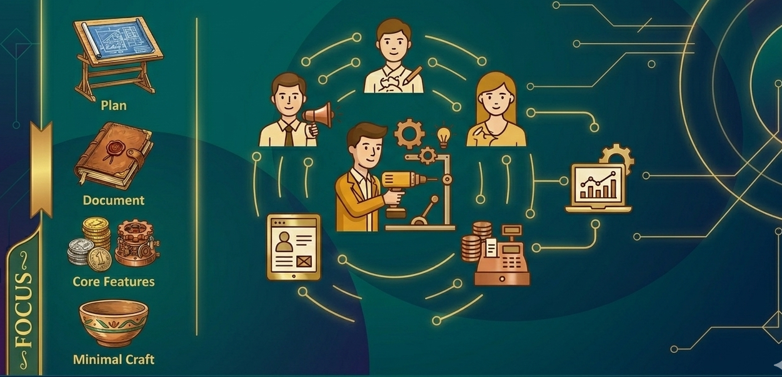
MVP SCOPE
Minimum Viable Product.
What's in..
✅ IN THE MVP
→ Photographer register & login (JWT auth)
→ Create & manage events with QR codes
→ Upload photos → AI face indexing
→ Guest selfie → instant photo match
→ Real-time processing dashboard (WebSocket)
→ Event catalog & browsing
FaceFind · MVP
5 / 9

Slide 14
TECHNOLOGIES
Full-Stack Technology Choices.
Frontend
Backend
React.js
Node.js + Express
Redux Toolkit
MongoDB + Redis
Tailwind CSS
JWT Auth
Socket.io
Machine Learning
Cloud & DevOps
Python + PyTorch
AWS S3 + CloudFront CDN
FastAPI
Docker Containers
InsightFace
GitHub Actions CI/CD
OpenCV + NumPy
Nginx Reverse Proxy
Complete MERN Stack + Python ML Microservice + Cloud Infrastructure (AWS)
FaceFind · CS 691 · Team 7
11 / 17

Slide 15
ALGORITHMS
ML / AI Algorithms Used.
🤖
🔍
🧠
ML / AI Algorithms
Face Detection
Face Embedding
Core framework
MTCNN / RetinaFace
ArcFace (InsightFace)
🔎
🗂️
👁️
Similarity Search
Clustering (Future)
Pattern Recognition
FAISS / pgvector
K-Means / DBSCAN
Deep Learning CNNs
FaceFind · CS 691 · Team 7

Slide 16


Slide 17
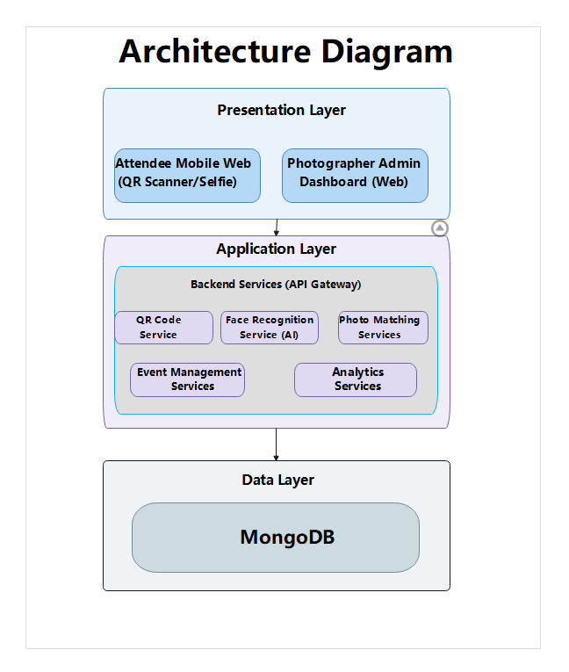
Architecture Diagram

Slide 18
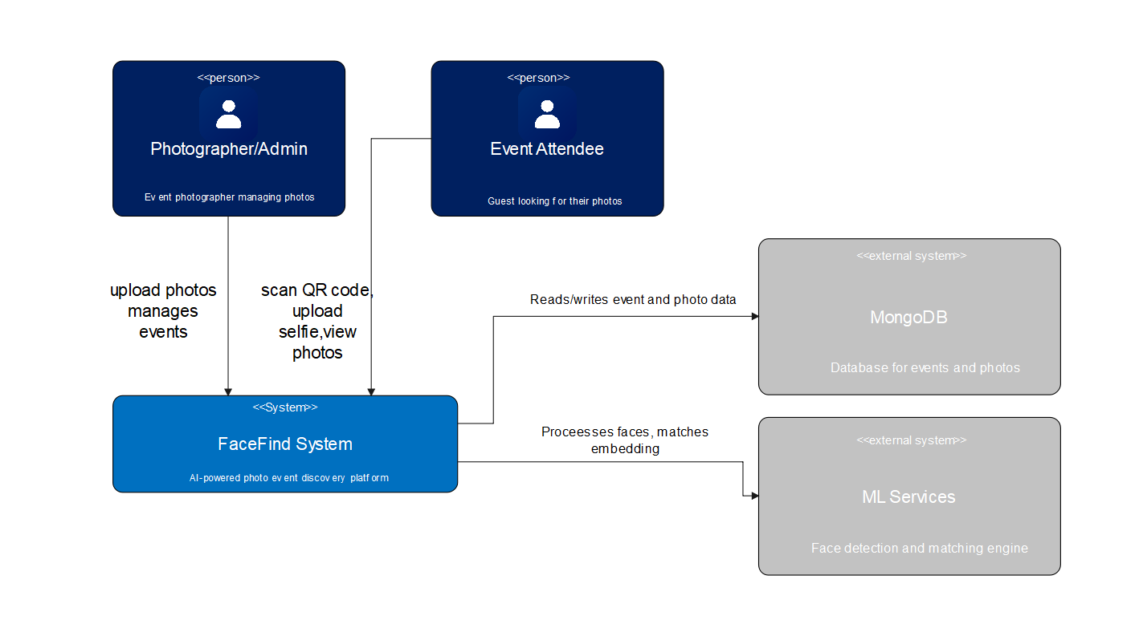
Context Diagram

Slide 19
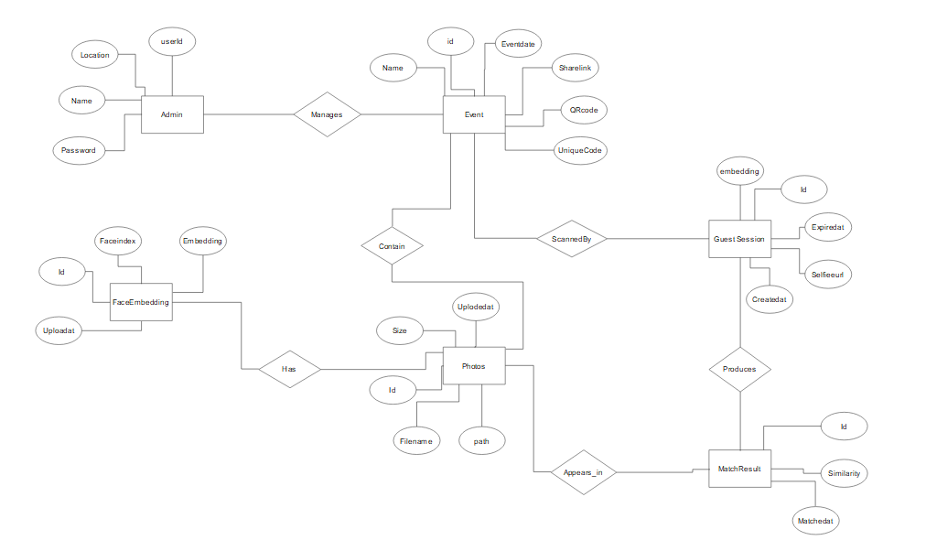
ER Diagram

Slide 20
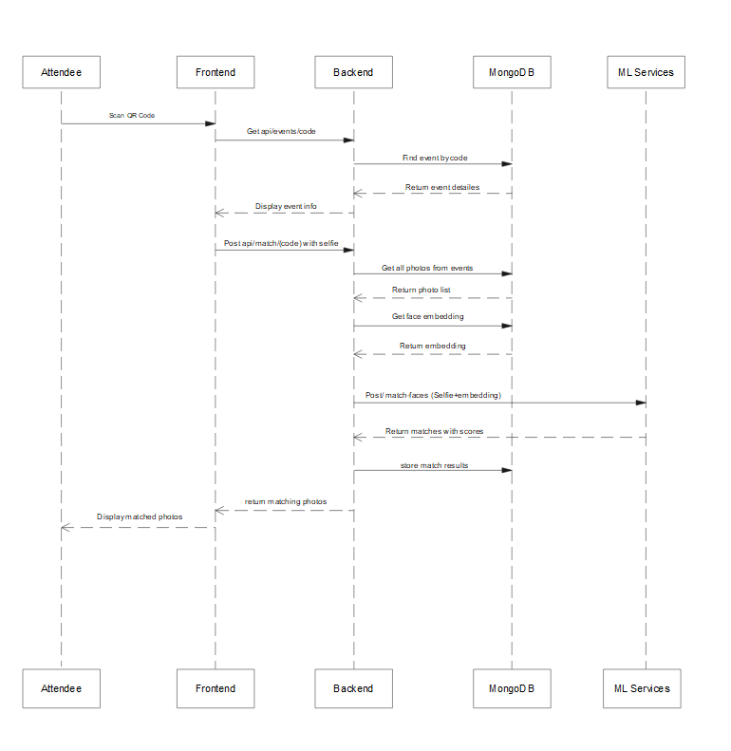
Sequence Diagram

Slide 21
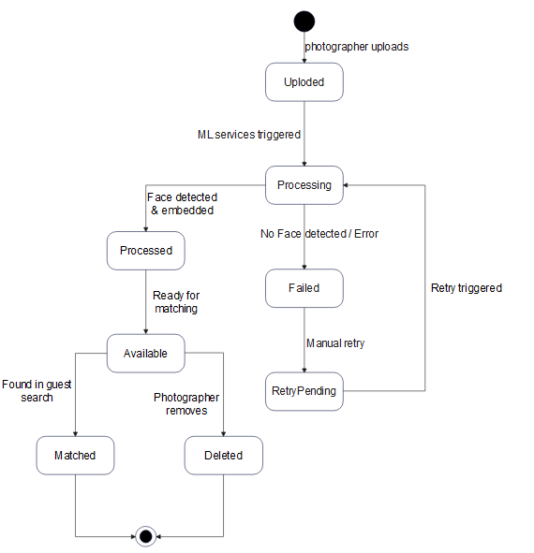
State Diagram

Slide 22
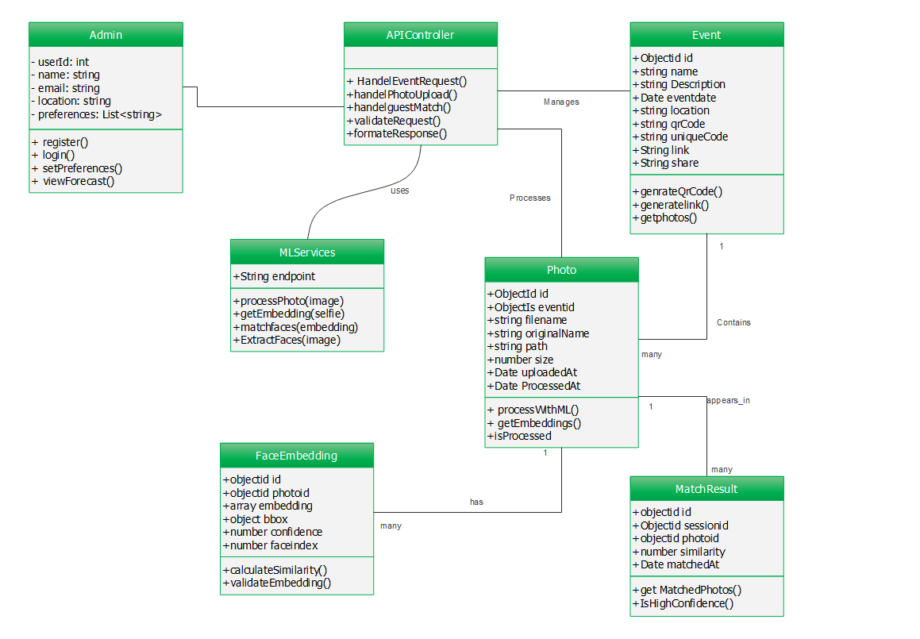
Class Diagram

Slide 23


Slide 24
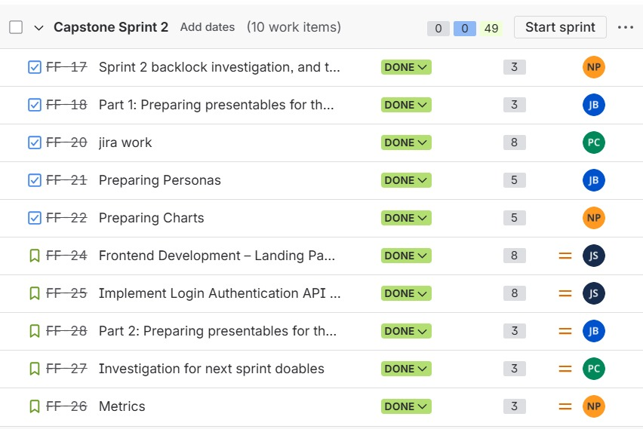
Sprint 1 Backlog

Slide 25
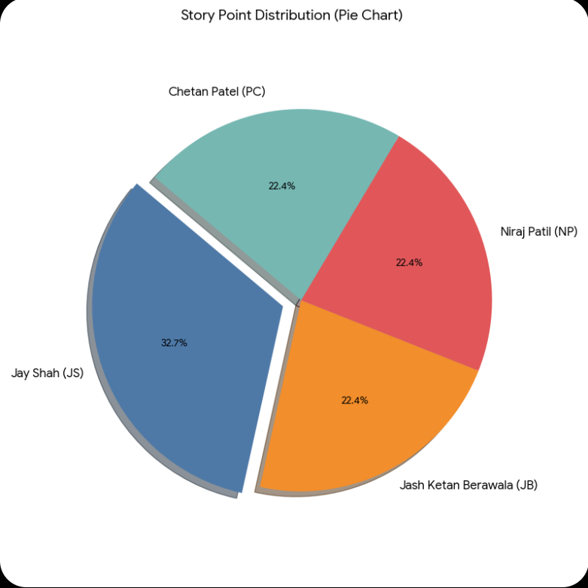
Sprint Velocity Metrics
A team's velocity chart tracks the amount of work completed in each sprint over a series of sprints, enabling the identification of trends and the prediction of future capacity. Velocity typically reflects the story points or work units a team can realistically commit to and successfully complete in a given iteration, a concept further explained by .
Here is the velocity data for "Capstone Sprint 2":
Sprint Name: Capstone Sprint 2
Total Committed Points: 49
Total Completed Points: 49
Zero Spillover
Velocity: 49
Team Manber Velocity Chart

Slide 26
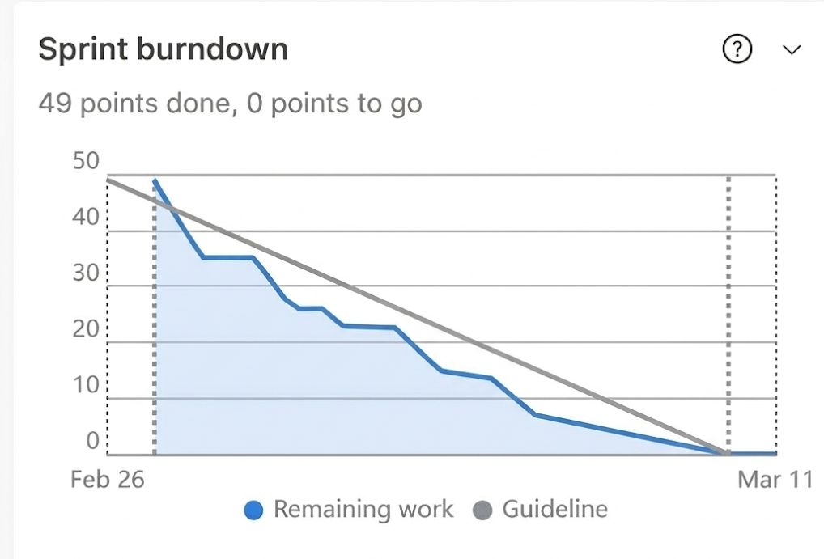

Slide 27
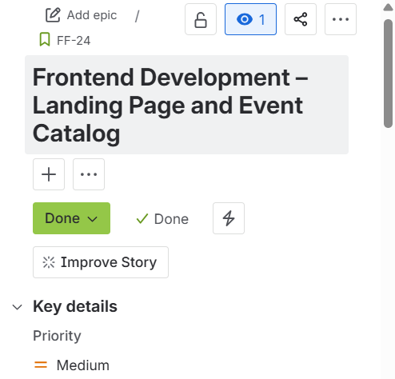
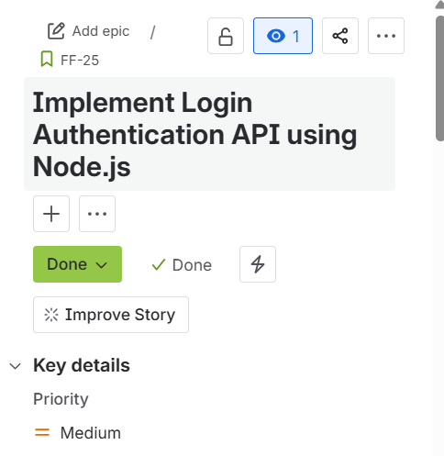
Technical Cards

Slide 28
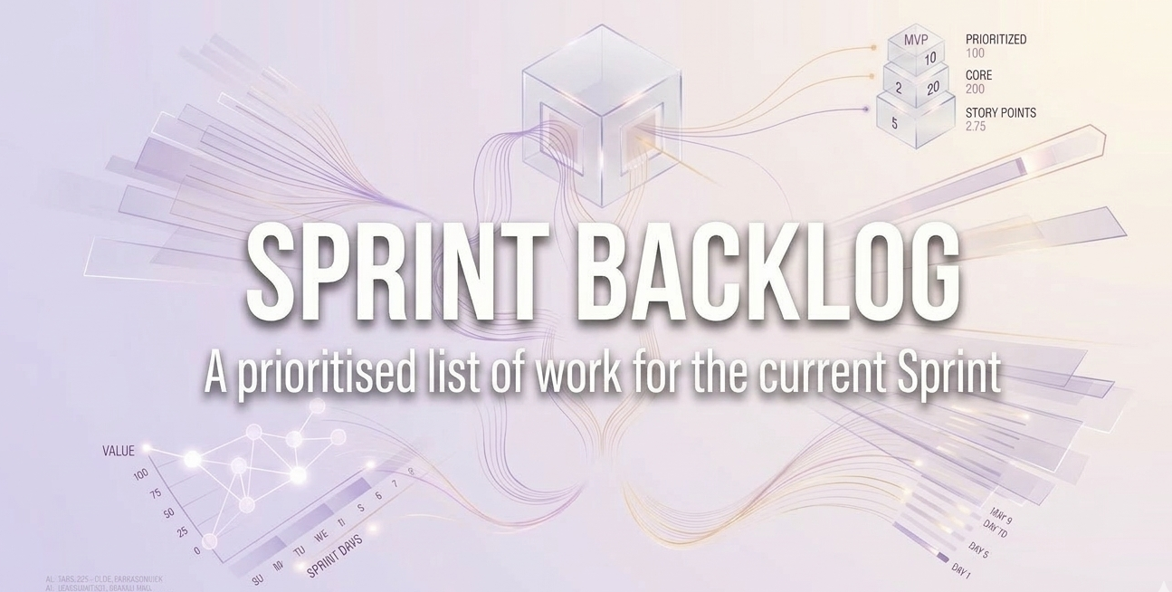

Slide 29
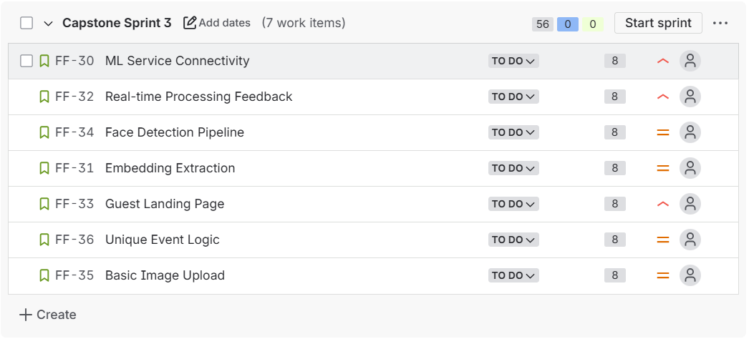
Sprint 2 Backlog

Slide 30
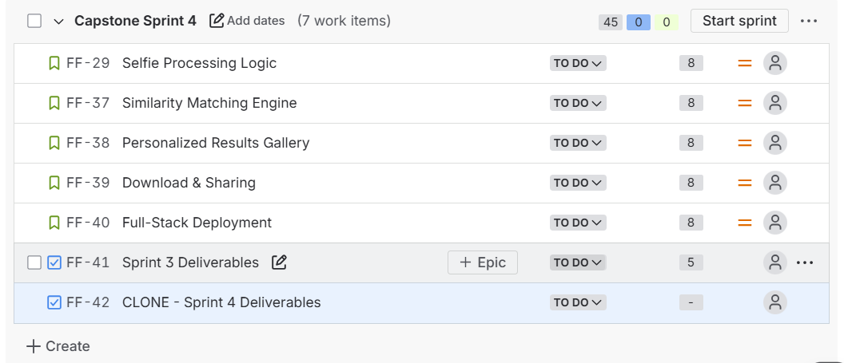
Sprint 3 Backlog

Slide 31
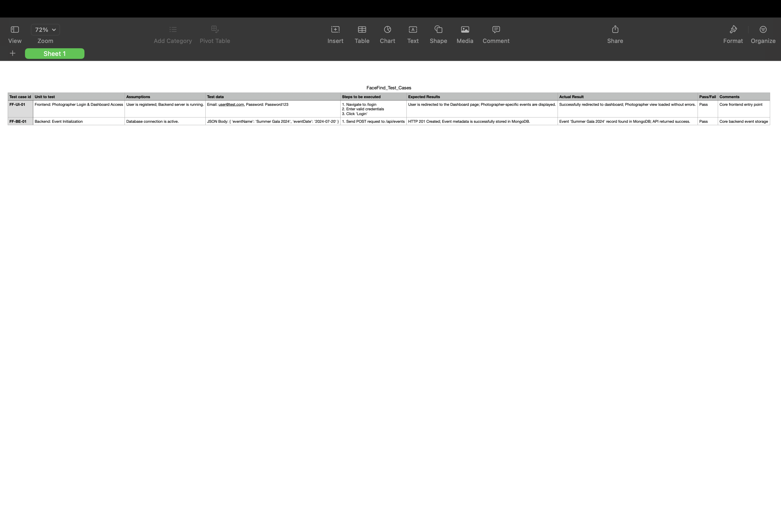
Test Cases

Slide 32


Slide 33

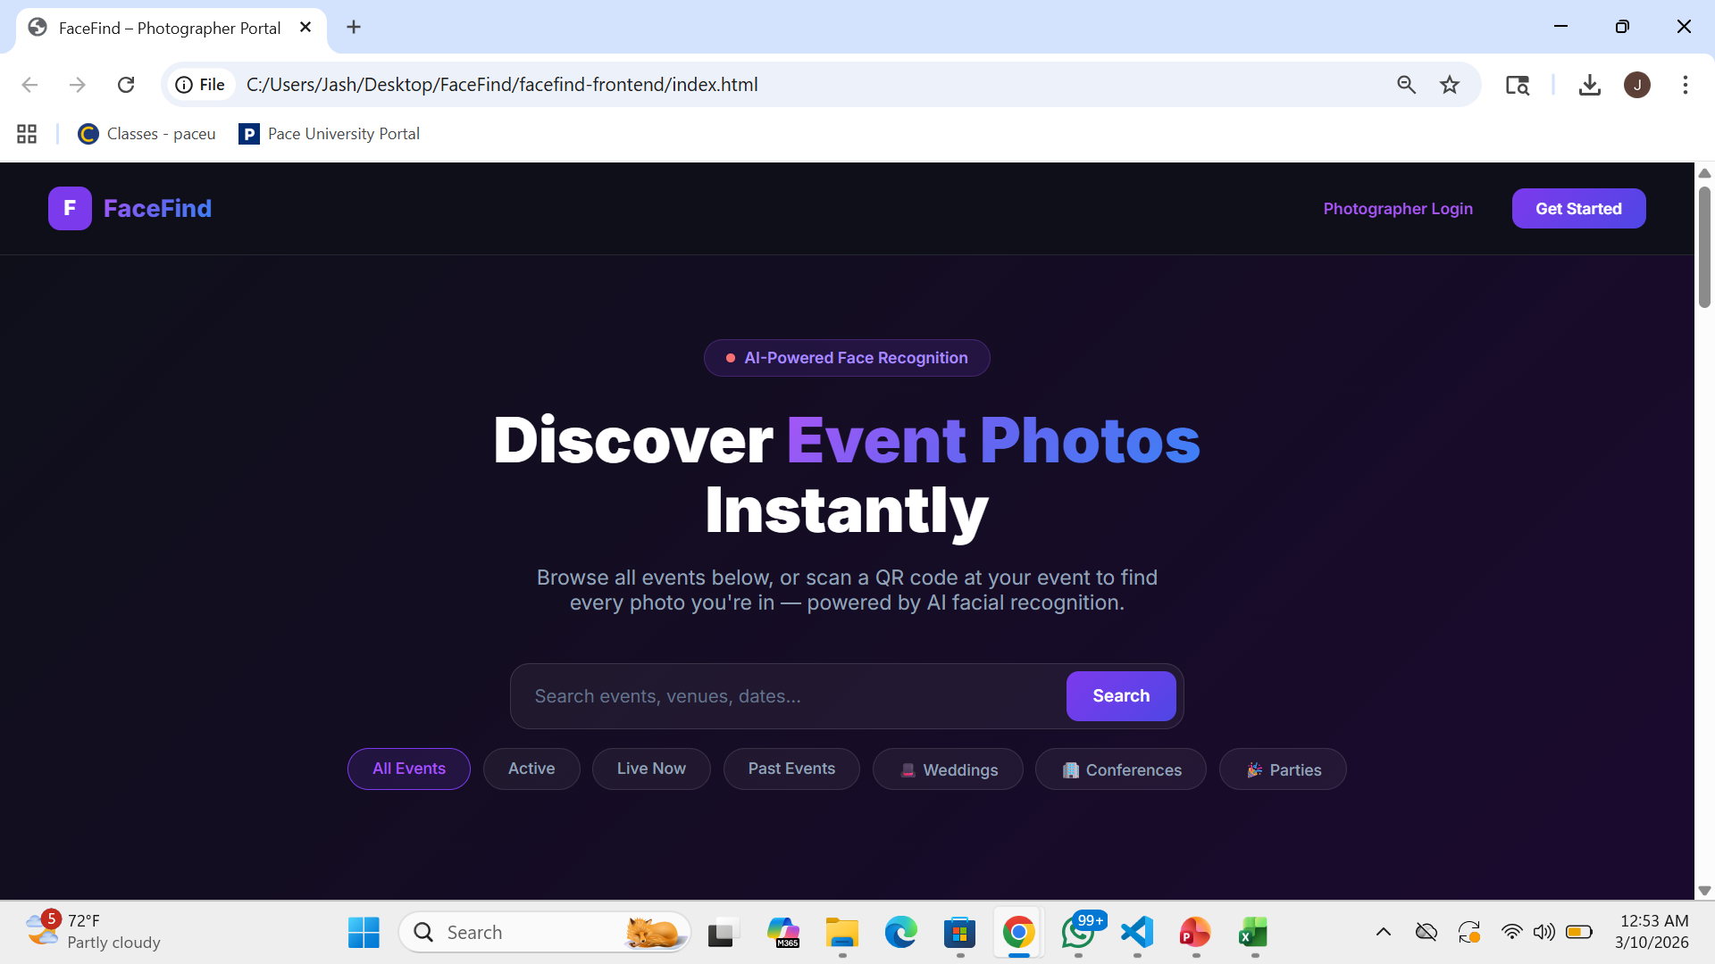
First Page ( Demo)

Slide 34
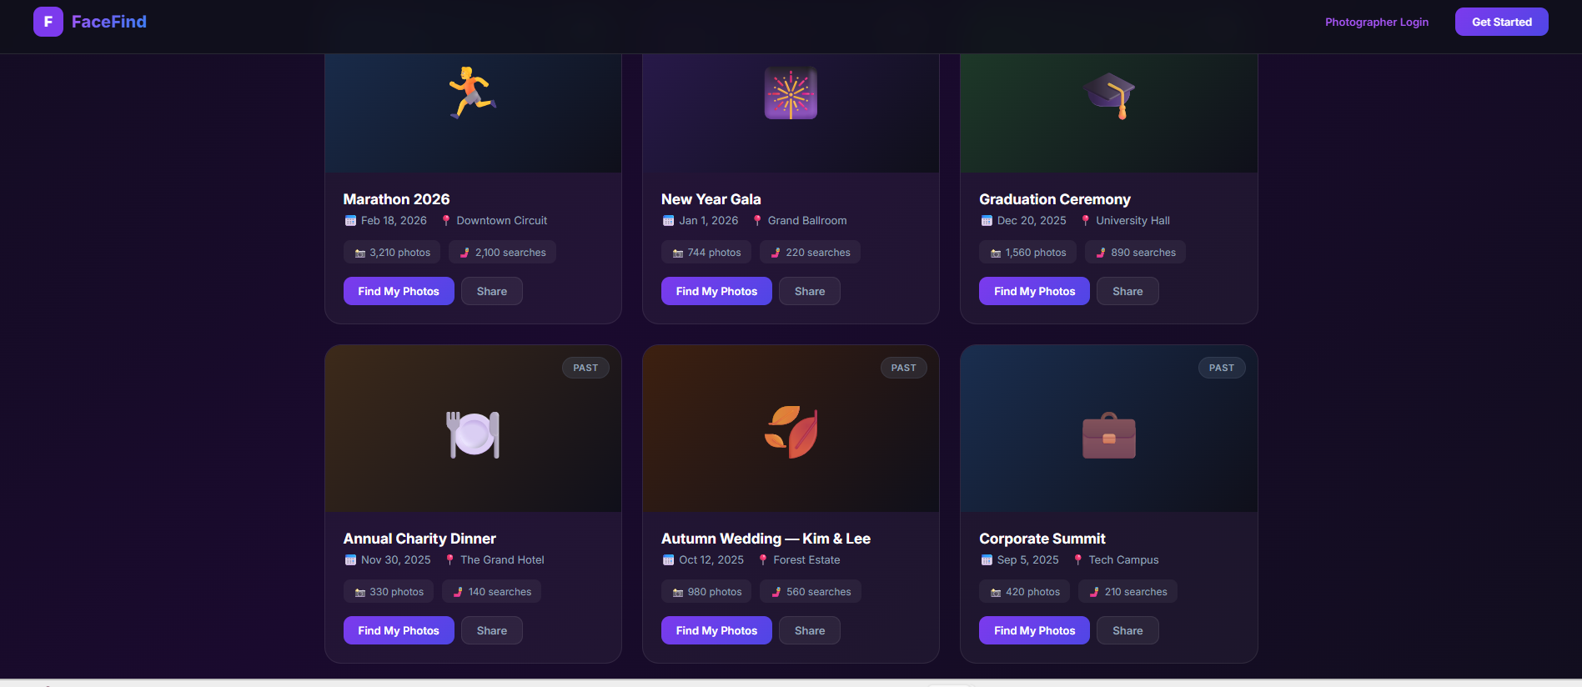
Catalog Page

Slide 35
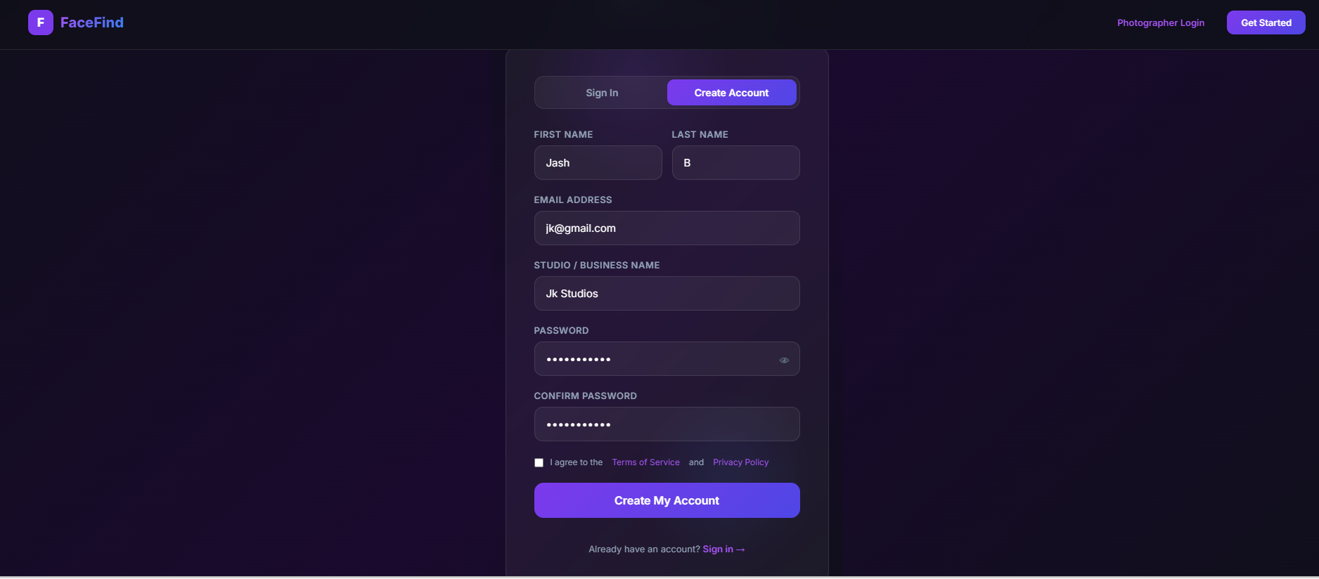
Register Page

Slide 36
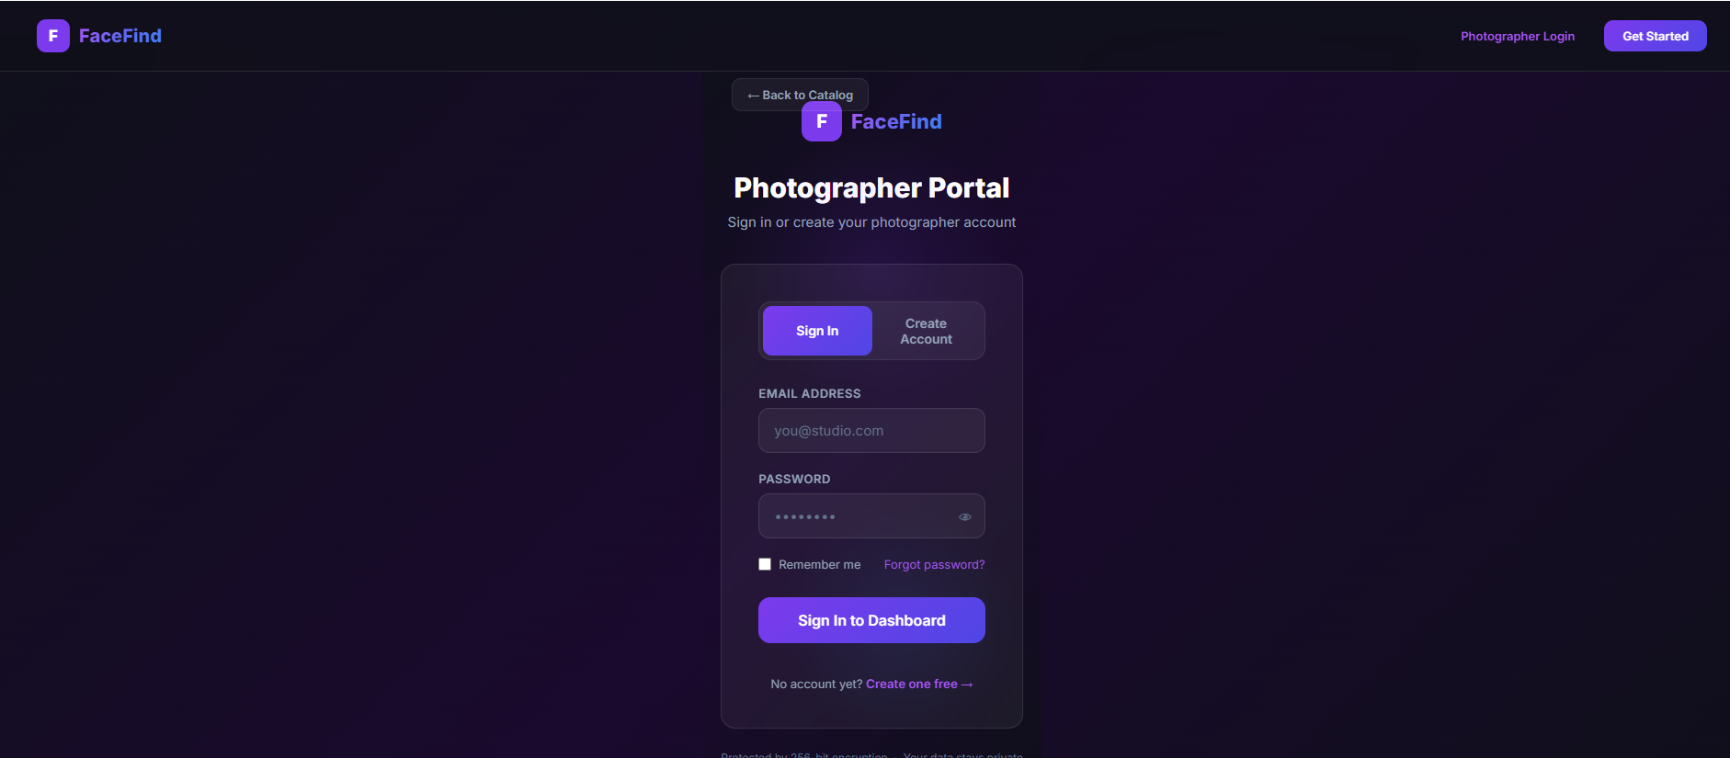
Login page

Slide 37
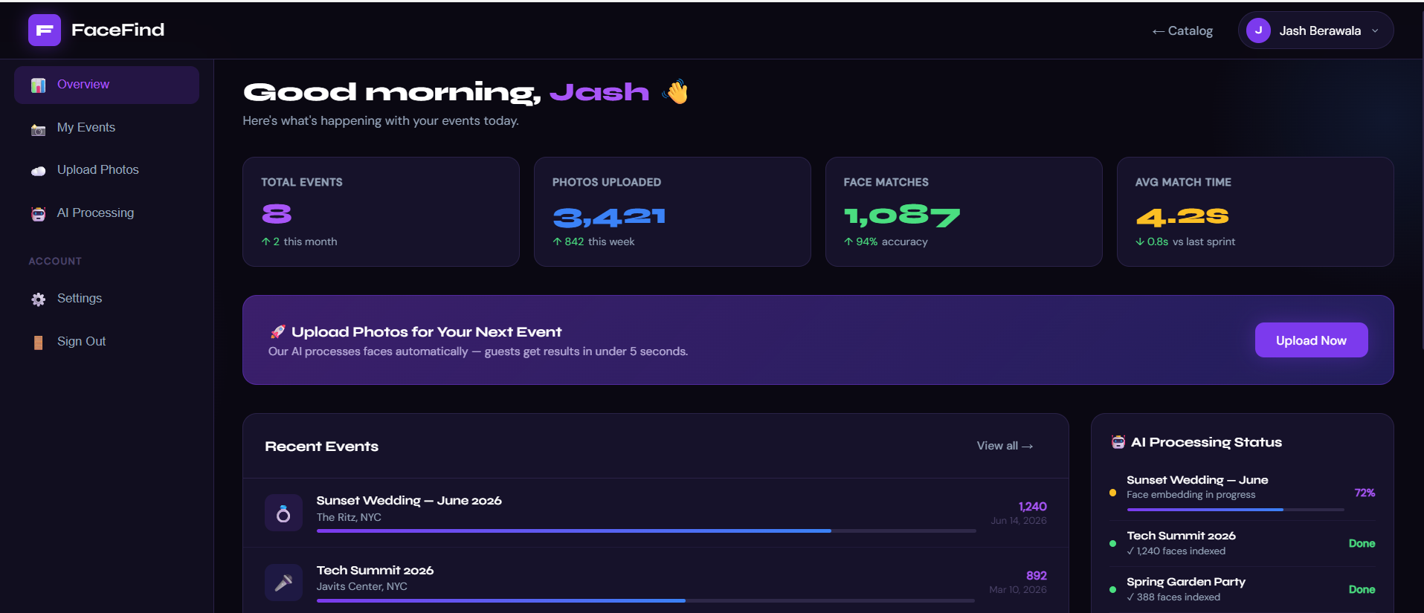
Dashboard Page (after Login)

Slide 38
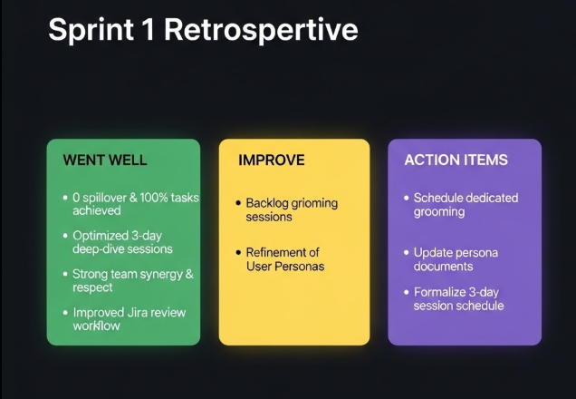

Slide 39
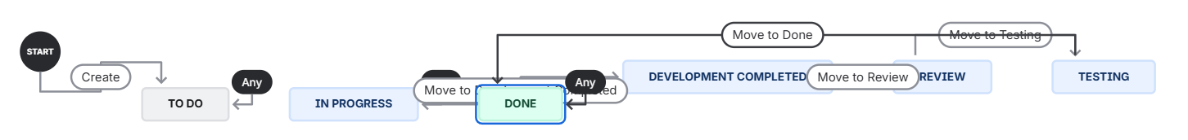
New Jira Workflow

Slide 40
F
Thank You!
Questions welcome.
📖
💻
📧
Group Wiki
GitHub Repo
Team 7
github.com/JashBerawala/Pace-Project-Team7/wiki
github.com/JashBerawala/Pace-Project-Team7
CS 691 · Pace University
FaceFind · CS 691 · Team 7

